Slide 1
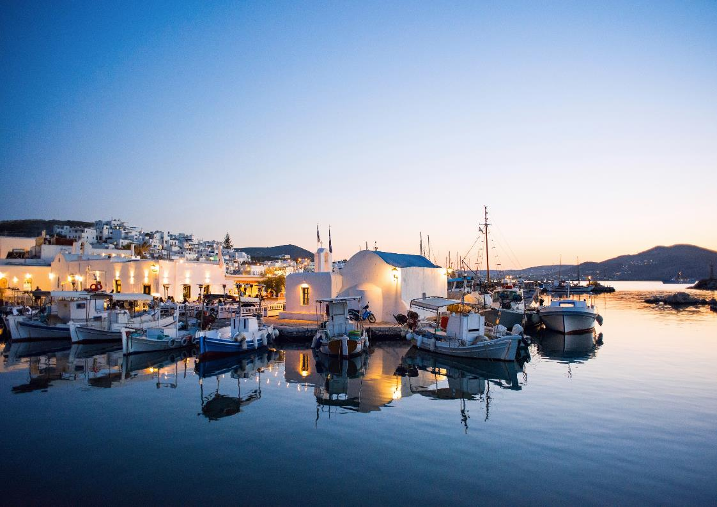

ATHENS, SANTORINI, FOLEGANDROS, PAROS
July&August 2021
T(GR): +30 210 680 1162
S: seez_travel
E: seez@ seeztrav el. com
W: www. seeztravel. com

Slide 2
Index
Athens Hotel Athens Perianth Parthenon & Acropolis Museum Tour Flavours of Athens | 04 05 06 07
Santorini Hotel Santorini Canaves Sunset Cruise Explore the beauty of the Cliff | 09 10 11 12
Folegandros Hotel Folegandros Anemi Exploring Folegandros | 14 15 16
Paros Hotels Paros Parilio Cooking Secrets from Paros Biking Tour | 18 19 20 21
Private Car Transfers | 22
Financial Offer | 23
Contact Details | 24

Slide 3
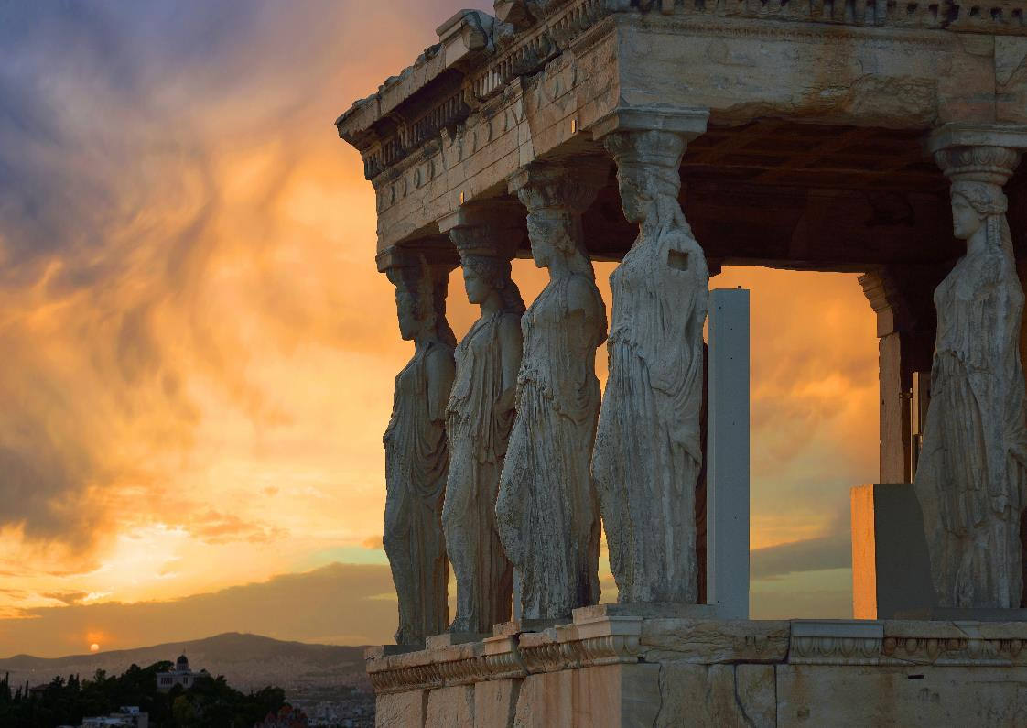
ATHENS

Slide 4
SYNOPSIS
SEEZ TRAVEL - ATHENS, SANTORINI, FOLEGANDROS, PAROS
Hotels Athens
26-28 July 2021 (2 nights)
Hotel | Location | Room Type & Size
Perianth Hotel | Athens Center | PERIANTH SUITE ACROPOLIS VIEW (36sqm)

Slide 5
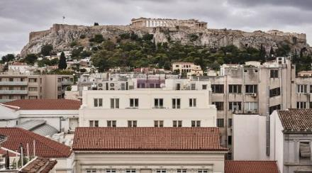
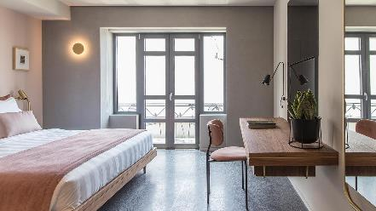

Perianth Hotel
SEEZ TRAVEL - ATHENS, SANTORINI, FOLEGANDROS, PAROS
Athens Center
At Perianth you won’t find your classic hotel corridor with rooms on each side, as it is not the boutique hotel you expect but a minimalist hotel with pastel colors on the walls, bronze and marble design elements and contemporary Greek art. In an interwar modernist building dating from the 1930s, enjoy the Agias Eirini’s church courtyard view and stay in a very carefully designed hotel with exceptionally well-mannered staff ready to pamper you. An absolute must be the stroll through the ancient sites of the historical centre of Athens which lie minutes from the hotel’s privileged location and await to amaze you.
PERIANTH SUITE ACROPOLIS VIEW (36sqm)
Payment Policy:
Full Prepayment
Cancellation Policy:
2 days prior to arrival day
Notes & Seez Benefits:
Daily breakfast buffet
Government Tax of EUR 4 per room per night is not included

Slide 6
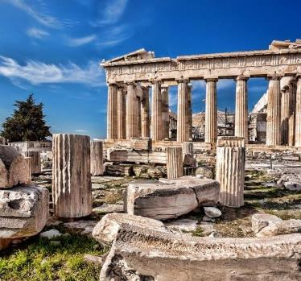
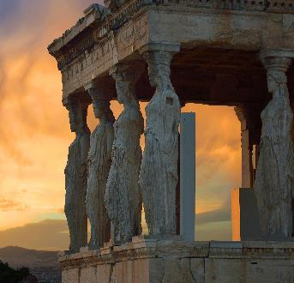
Parthenon & Acropolis Museum Tour
SEEZ TRAVEL - ATHENS, SANTORINI, FOLEGANDROS, PAROS
Athens
Your guide will take you to the legendary Acropolis hill. Using Augmented Reality on the Ipad, you will see the monuments in their original splendor, as they were when they were first executed. You will travel back in time and walk through the Parthenon as it once was, gazing at the colors on the columns and statues as if they had never faded away.
Follow your guide to Acropolis museum, rated by National Geographic as one of the top 10 museums in the world and discover the ancient artifacts found in the Acropolis’ area, viewed in all their glory enhanced by the brightness of the natural light intruding from the large glass panes.
Get acquainted with the ancient heart of the city & its most iconic archeological landmarks of Athens
Includes:
4-hour private guided tour in total (2-hour guided tour to the Acropolis, 2-hour guided tour to the Acropolis Museum)
Hotel pick-up walking-from central hotel
Entry fees to the archaeological site(s)
Augmented Reality iPad for Acropolis (1 per person)
Private services of a state-licensed guide
Coffee or refreshment
Taxes
Cancelation Policy:
15 days prior to the tour

Slide 7
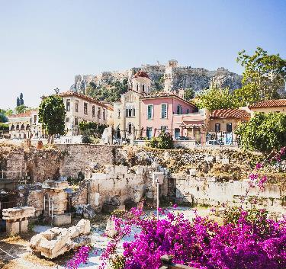
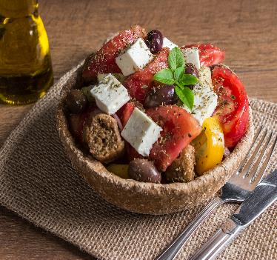
Flavours of Athens
SEEZ TRAVEL - ATHENS, SANTORINI, FOLEGANDROS, PAROS
Athens
Greece is famous for its local spirits and meze that bring everyone closer! Get an authentic taste of Greek culture at a nice traditional establishment. There are numerous cuisine styles to choose from.
During this private food tour you will not only explore the streets of Athens but you will also get to taste appetizing treats that locals enjoy as part of their daily routine.
You will visit artisans that have perfected their recipes over decades, as well as specialist food stores sourcing the best products from all over Greece. A culinary tour would not be complete without a visit to the city’s vibrant central food market where local vendors exhibit their products from across the country.
Flavours of Athens
Includes:
All taxes
4-hour private walking tour
Hotel pick-up (Walking)
Sampling of local beverages and delicacies
Private services of a food wise “Insider” tour leader
Cancelation Policy:
15 days prior to the tour

Slide 8
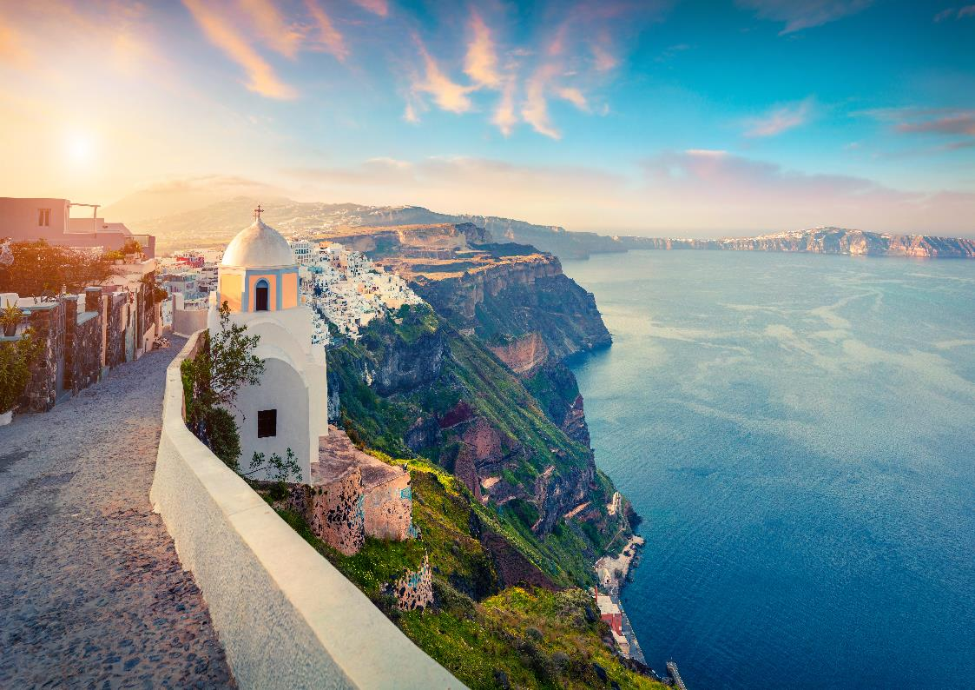
SANTORINI

Slide 9
SYNOPSIS
SEEZ TRAVEL - ATHENS, SANTORINI, FOLEGANDROS, PAROS
Hotels Santorini
28-31 July 2021 (3 nights)
Hotel | Location | Room Type
Canaves Oia Suites | Oia | Junior Suite Plunge Pool Caldera Sea View Or Superior Suite Plunge Pool Caldera Sea View

Slide 10
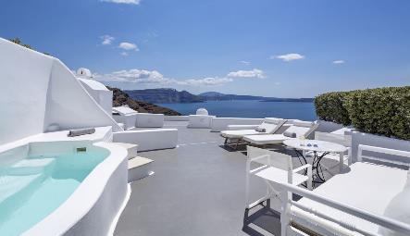
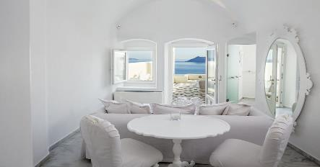
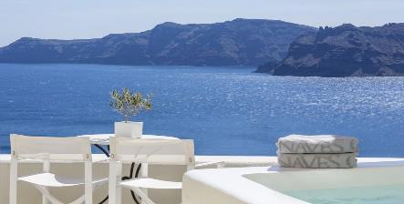
Canaves Oia Suites
SEEZ TRAVEL - ATHENS, SANTORINI, FOLEGANDROS, PAROS
Oia, Santorini
Enveloped by the deep blue colour of the Aegean and the awe-inspiring dramatic beauty of Santorini, Canaves Oia Suites welcomes its guests to a world of exquisite elegance. Combining spectacular views of the mesmerizing Caldera with over-the-top accommodation and pampering service, these luxury suites will charm every guest. Canaves Oia Suites & Spa provide luxurious accommodation in spacious suites and rooms, beautifully appointed with antique furniture and art objects. A very carefully directed hotel that offers privacy ready to welcome you and make you feel at home.
Junior Suite Plunge Pool Caldera Sea View Or Superior Suite Plunge Pool Caldera Sea View
Payment Policy:
Full Prepayment
Cancellation Policy:
21 days prior arrival
Seez notes & Benefits:
VIP amenities: fruit basket and mineral water in the room upon arrival
Daily American a la Carte or Room Service Breakfast
Local traditional gift
Complimentary Wi-Fi internet connection
Early check-in upon / Late check-out upon availability
Room upgrade upon availability
Government Tax of EUR 4 per room per night is not included and must be paid directly at the hotel

Slide 11
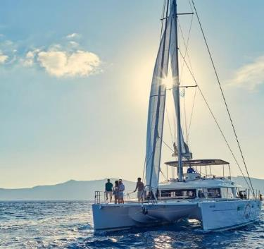
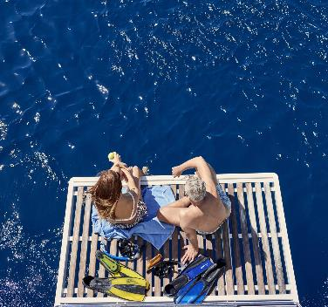
Sunset Boat Tour
SEEZ TRAVEL - ATHENS, SANTORINI, FOLEGANDROS, PAROS
Santorini
Starts from Vlychada port at 15:15 pm.
1st Stop: In the area of Red beach for swimming and snorkeling. (approximately 30 minutes)
2nd Stop: In the secluded area of White beach & Mesa Pigadia, for swimming - snorkeling and for the barbecue on board. (approximately 1 hour and 30 minutes).Sails past Aspronisi, Lighthouse, Indian rock, Black Mountain.
3rd Stop: In the area if the Hot Springs for swimming close to the Volcano (approximately 30 minutes).
4h Stop: Sail inside the Caldera for photo shooting. A stop below the picturesque village of Oia for watching the sunset.
Final Stop
Tour ends at Ammoudi (after the sunset).
Sunset Boat Tour
Includes:
4-5 hours duration
VAT
Round trip transfers from and to the hotel
Greek traditional snacks prepared on the spot
Drinks (soft drinks, white Santorinian wine, beer, ouzo)
Snorkeling Equipment
Towels (to be returned to the crew)
Jacket (to be returned to the crew)
Map with extensive info on the landmarks and destinations
Free Wifi
Cancelation Policy: 15 days prior to the tour
Important Note:
All yachts and boats in Greece cannot moor directly on the beach. We have selected the best points for swimming and snorkeling, the closest possible from the beach.

Slide 12
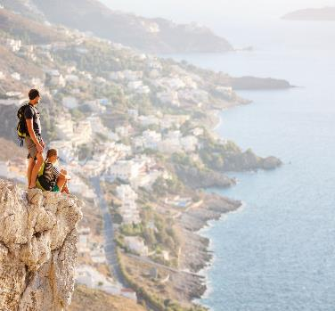
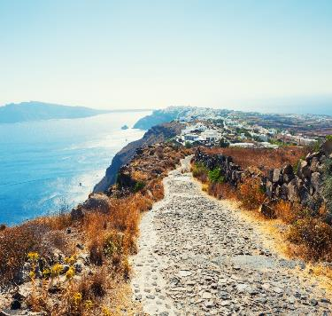
Explore the beauty of the Cliff
SEEZ TRAVEL - ATHENS, SANTORINI, FOLEGANDROS, PAROS
Santorini
Enjoy a light hike through the landscape of the island and engage with the locals.
Santorini is an Island that is all interconnected by hiking paths. For a long time this was the way locals moved between villages.
The most famous path is the one on the cliff side connecting the two main villages of the island Fira and Oia. A walk of 10 km always on the rim of the caldera, it was the only way to reach the village of Oia inland, by the islanders up until the mid seventies.
It offers breathtaking views of the crater lake and all the north side of the island, with picturesque whitewashed villages perched on the cliff top and wide areas of raw natural beauty. Arriving at our destination village it is time for a well deserved rest at a cafe to enjoy a local sweet.
It is unique experience, well worth it, if you enjoy fresh air and stunning views.
Different paths are available with different levels of difficulty.
Explore the beauty of the Cliff
Includes:
4 hours duration
Host
Water and a local snack
Hiking poles are available upon request
Round transfer to and from to the hotel
Cancelation Policy: 15 days prior to the tour

Slide 13
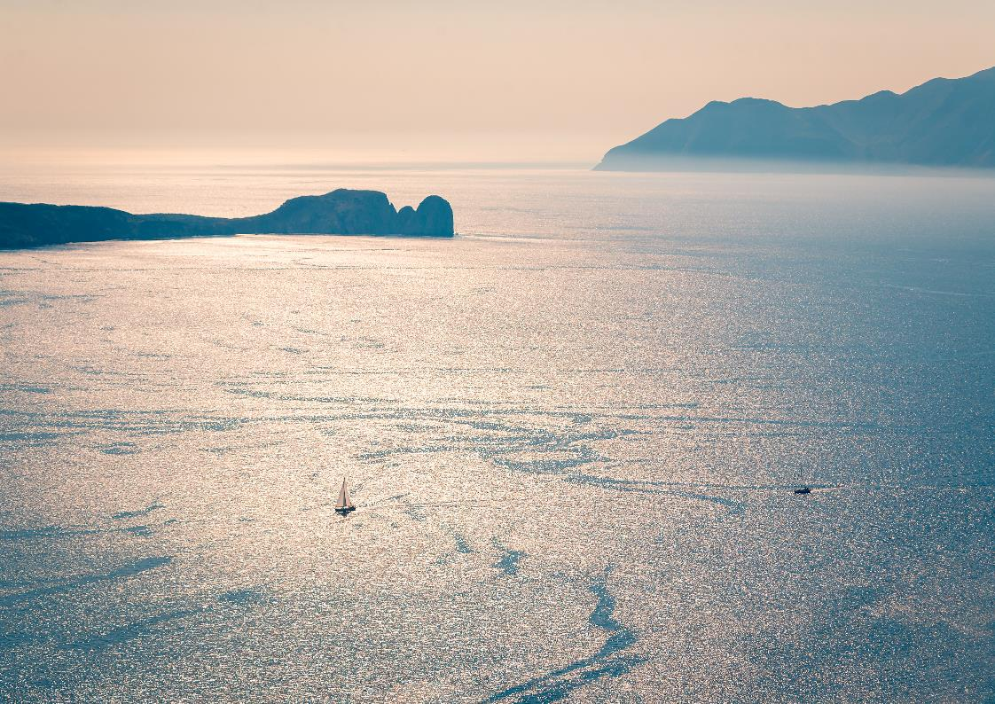
FOLEGANDROS

Slide 14
SYNOPSIS
SEEZ TRAVEL - ATHENS, SANTORINI, FOLEGANDROS, PAROS
Hotel Folegandros
31 July – 02 August 2021 (2 nights)
Hotel | Location | Room Type & Size
Anemi Hotel | Karavostasis | Elegant Sea View Room (35sqm) Or Junior Suite (42sqm)

Slide 15
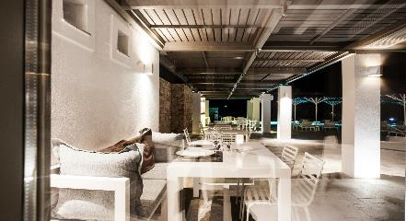
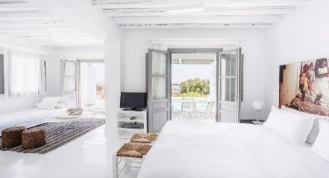
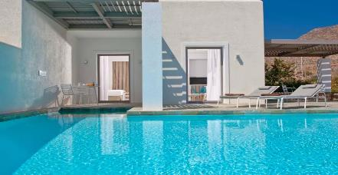
Anemi Hotel
SEEZ TRAVEL - ATHENS, SANTORINI, FOLEGANDROS, PAROS
Karavostasis
Located minutes away from Chora and a few minutes walk from the pebbled beach, the Anemi Boutique Hotel successfully combines Cycladic architecture with contemporary design guaranteeing an extraordinary hospitality experience. Nestled within the rugged Cycladic landscape, 44 luxurious rooms and impeccable suites, facing the Aegean Sea and Folegandros Port, offer 5-Star accommodation and services.
Elegant Sea View Room (35sqm) Or
Junior Suite (42sqm)
Payment Policy:
Full Prepayment
Cancellation Policy:
21 days prior to arrival
Notes & Seez Benefits:
Daily breakfast a la carte
Government Tax of EUR 4 per room per night is not included and must be paid directly at the hotel

Slide 16
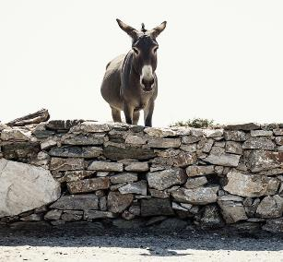
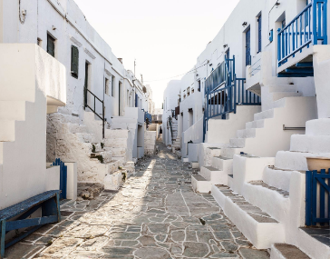
Exploring Folegandros
SEEZ TRAVEL - ATHENS, SANTORINI, FOLEGANDROS, PAROS
Folegandros
This island has a quiet beauty, amplified by the clifftop Hora, one of the most picturesque villages in the Cyclades. Visit the church of Panagia, one of the most famous sights of Folegandros and one of the most beautiful of Greece. Go to Ano Meria village and visit a traditional grocery in Ano Meria village. You will immerse yourself into the local atmosphere and enjoy local flavors in the grocery where an elderly lady will cook for you. Visit the folklore museum and a Themonia (traditional farmer house). “Climb” to the Kastro (castle) of Hora village. The uniqueness and authenticity of the castle of Folegandros combined with the particular architecture will travel the visitor into another era.
Exploring Folegandros
Includes:
Duration: 4.5hrs
English Speaking Escort
Road transfers with luxury minivan
Cancelation Policy: 20 days prior to the tour

Slide 17

PAROS

Slide 18
SYNOPSIS
SEEZ TRAVEL - ATHENS, SANTORINI, FOLEGANDROS, PAROS
Hotel Paros
02-04 August 2021 (2 nights)
Hotel | Location | Room Type & Size
Parilio Hotel | Naoussa, Kolympithres | Aurora Suite (30sqm) Or Halo Suite (40sqm)

Slide 19
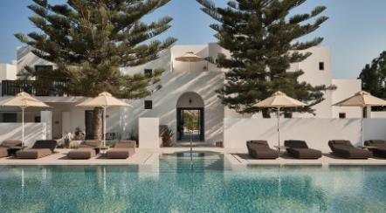
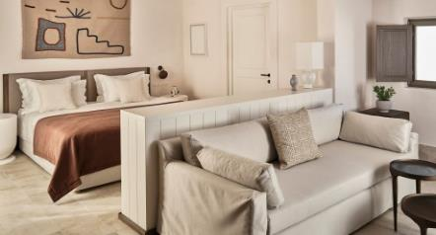
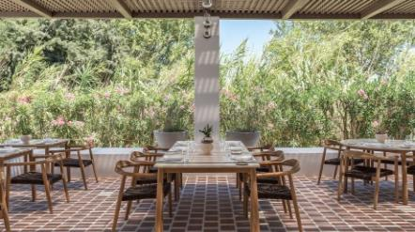
Parilio Hotel
SEEZ TRAVEL - ATHENS, SANTORINI, FOLEGANDROS, PAROS
Naoussa, Kolympithres
Cycladic architecture and holistic spirit beckon at the Parilio Hotel, an opulent retreat in full harmony with the unspoiled nature of Kolympithres beach and Naoussa bay that lie in front. Walk through the arches and the concrete columns of the lobby and you enter a sanctuary. Earthy colors and terracotta floors alongside marble figurines create a soothing ambiance.
Aurora Suite (30sqm) Or
Halo Suite (40sqm)
Payment Policy:
Full Prepayment
Cancellation Policy:
21 days prior to arrival day
Notes & Seez Benefits:
Daily American Buffet Breakfast
Complimentary porterage service
Complimentary WIFI
Government Tax of EUR 4 per room per night is not included and must be paid directly at the hotel

Slide 20
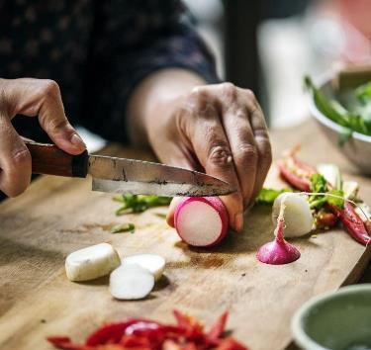
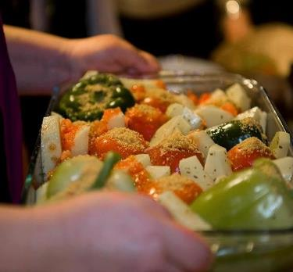
Cooking Secrets from Paros
SEEZ TRAVEL - ATHENS, SANTORINI, FOLEGANDROS, PAROS
Paros
Everyone knows that Greek cuisine is among the best in the world! But we know recreating the quality and style of food when you return home is not so easy....until now!
We offer an authentic cooking lesson with a friendly local professional. Whatever your tastes; we provide a range of 3 traditional Greek dishes for you that represent the very best of Hellenic cooking, once mastered you will be ready to impress your friends and family at home. We will join you at your villa or we can provide a fantastic kitchen.
Our chef does so much more than simply teach you the recipes, she will explain about the local produce and the history of the dishes and once you have prepared your dishes you can sit back and relax with a glass of quality local wine. This activity is great fun for families, couples or groups of friends.
Cooking Secrets from Paros
Includes:
All taxes
Duration: 3 hours
Local professional cook to provide cooking lesson of 4 traditional Greek dishes, includes all ingredients
Road transfers with BMW SUV OR Mercedes minivan
Notebooks
Wine tasting
Greek coffee
Juice and mineral water
Cancellation Policy: 92 days prior to the tour

Slide 21
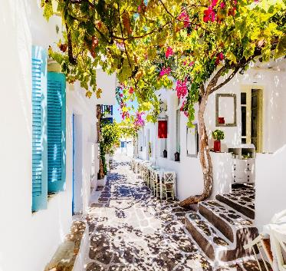
Biking Tour
SEEZ TRAVEL - ATHENS, SANTORINI, FOLEGANDROS, PAROS
Paros
Join us for a bicycle tour around some of the most iconic spots of Paros.
Our experienced local guide will take you on a three hour journey around some of Paros' beautiful traditional villages, the famous ancient quarries and monuments.
Starting in the villages of Lefkes in the centre of the islandyou will gently descend finishing in the magical town of Naoussa, in a period of over 3 hours.
What is really special about this tour is that it is 95% off-road, making it safe and accessible for all ages and abilities.
We provide the bike and helmet for you and all you need in between.
*Appropriate shoes and sport clothing are needed
Biking Tour
Includes:
All taxes
Duration: 3 hours
Experienced guide
Equipment (includes bicycles & helmets)
Mineral water (1L / person)
Road transfers between hotel / villa and activity with BMW SUV OR Mercedes minivan
Cancellation Policy: 92 days prior to the tour

Slide 22
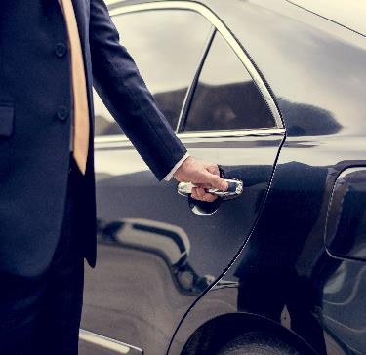

Private Car Transfers
SEEZ TRAVEL - ATHENS, SANTORINI, FOLEGANDROS, PAROS
Athens
Athens Airport – Athens Hotel
Athens Hotel – Athens Airport
With Luxury Car A6, BMW S-40 or similar
Santorini
Santorini Port / Airport – Santorini Hotel
Santorini Hotel – Santorini Port / Airport
With Mini Bus Vito 8 seats Mercedes or similar
Folegandros
Folegandros Port – Folegandros Hotel
Folegandros Hotel – Folegandros Port
With Luxury Car
Paros
Paros Airport – Paros Hotel
Paros Hotel – Paros Port
With SUV BMW or mini-van Mercedes or similar
Private Car Transfers
Includes:
All taxes and services included
English speaking driver
Driver will wait at the arrivals holding a sign with client’s name
Cancelation Policy: 10 days prior to the service

Slide 23
Financial Offer
SEEZ TRAVEL - ATHENS, SANTORINI, FOLEGANDROS, PAROS
Starting rate for 2 people €12.240
Inclusions: Itinerary of 9 nights / 10 days itinerary
Athens
Transfer upon arrival & departure with luxury car
Accommodation at Perianth, Suite Acropolis View (2 nights)
Parthenon & Acropolis Museum Tour
Flavours of Athens
Flight Business Seats Athens-Santorini
Santorini
Transfers upon arrival and departure with luxury car
Accommodation at Canaves, Junior Suite Plunge Pool (3 nights)
Sunset Cruise
Explore the beauty of the Cliff
Ferry Business Seats Santorini-Folegandros
Folegandros
Transfer upon arrival & departure with luxury car
Accommodation at Anemi, Elegant Sea View Room (2 nights)
Exploring Folegandros
Ferry Business Seats Folegandros-Paros
Paros
Transfer upon arrival & departure with luxury car
Accommodation at Parilio, Aurora (2 nights)
Cooking Secrets from Paros
Biking Tour
Exclusions:
Meals not included in the itinerary
Accommodation Government Tax of EUR 4 per room per night are to be paid directly at the hotel
Personal expenses
International flights
Domestic flights / ferries
Visa expenses
*The offer is based on an itinerary for 2 pax in July-August 2021.
**No any reservation has been made.
***Rates and availability are subject to change.

Slide 24

Contact Details
www.seeztravel.com seez@seeztravel.com
Athens
11, Korinthou st, 144 51 Metamorfosi, Athens, Greece
T: +(30) 210 680 1162
Seize Your Time ‘In-Between’

